Slide 1

Cron

Slide 2

The term "cron" comes from the Greek word "chronos," which means "time." Cron is a time-based job scheduler that was originally developed for Unix-like operating systems in the 1970s. The name "cron" was chosen because the tool's main function is to run jobs at specific intervals or times.
Cron has since become a widely used and highly flexible tool for scheduling jobs and automating tasks on Unix and Unix-like systems. It is named after the "cron" daemon, which runs in the background and checks the crontab file at regular intervals for jobs to execute.
Cron is now available on many different operating systems, including Linux, macOS, and Windows, and has become a standard tool for system administrators and developers alike.

Slide 3
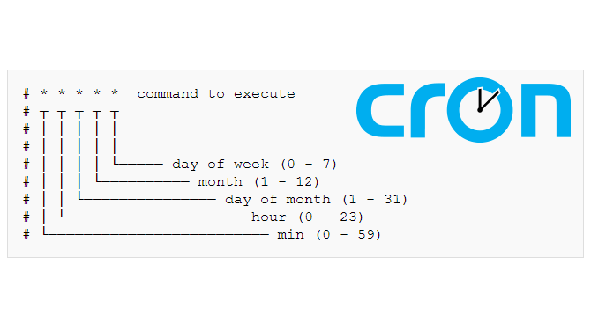
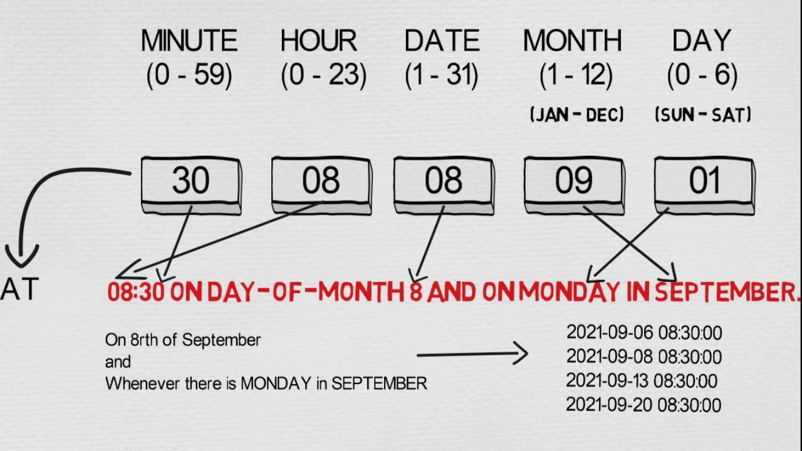

Slide 4
*/5 * * * *
every 5 minutes
0 12 * * 1-5
every weekday at noon
0 0 * * 1 * *
every Monday at midnight
0 0 * * *
every day at midnight
0 0 * * 0
every Sunday at midnight
0 0 * * 6
every Saturday at midnight
0 0 1 * *
on the 1st day of every month at midnight
0 0 1-7 * *
every day from the 1st to the 7th of the month at midnight
0 0 1 * 1
on the first Monday of every month at midnight
0 0 * * 1-5
every weekday at midnight
0 0 1 * 1-6
on the first day of the month, if it falls on a weekday (Monday to Saturday), at midnight.

